Slide 1
IT3011 — THEORY AND PRACTICES IN STATISTICAL MODELLING — STATX
"Employees Who Receive Regular
Feedback Perform Better Than
Those Who Do Not"
IT23698536 - WEERASINGHE N.H
IT23686410 - SENEVIRATHNE D.V.S
IT23703094 - DE SILVA W.H.P.P
IT23702622 - G.HARAN AKASH
Datasets: Employee.csv + PerformanceRating.csv | Significance level: alpha = 0.05

Slide 2
Problem Statement
What we are investigating and why it matters
"Employees who receive regular feedback perform better than those who do not"
Why This Matters
Hypotheses
Performance is a key business outcome in any organisation
If proven, organisations can invest in structured feedback programmes
This study tests a widely held workplace assumption using real data
H0: No significant difference in manager rating between groups H1: Regular feedback group has significantly higher manager ratings Significance level: alpha = 0.05

Slide 3
Objectives
What this assignment sets out to achieve
Data Collection
Inferential Analytics
01
05
Collect and merge two secondary datasets using R
Run 4 statistical tests to test the hypothesis
Preprocessing
Predictive Analytics
02
06
Clean data, check missing values, engineer variables
Build regression models to predict performance
Descriptive Analytics
Final Decision
03
07
Summarise and compare performance across feedback groups
Justify conclusion based on statistical evidence
Time Series
04
Track performance trends over 10 years of review data

Slide 4
Data Collection
Secondary datasets provided for the module
Dataset 1 — Employee.csv
Dataset 2 — PerformanceRating.csv
1,470 employee records | 23 variables
Key variables: EmployeeID, Department,
JobRole, Age, Salary, YearsAtCompany, Attrition
6,709 review records | 11 variables
Key variables: EmployeeID, ManagerRating,
SelfRating, TrainingOpportunitiesWithinYear,
TrainingOpportunitiesTaken, ReviewDate
Key Variables Selected
Independent Variable (IV): TrainingOpportunitiesWithinYear — proxy for regular feedback Dependent Variable (DV): ManagerRating (scale 2–5) — measure of performance

Slide 5
Data Preprocessing
Merging, cleaning, and preparing data for analysis in R
1
Merge Datasets
inner_join() on EmployeeID — combines both files into 6,709 rows with all variables
2
Missing Value Check
is.na() on all key columns — result: 0 missing values found in every column
3
Feature Engineering
FeedbackGroup: sessions >= 2 = Regular Feedback, 1 = No Regular Feedback
HighPerformer: ManagerRating >= 4 = High, below 4 = Low
4
Date Conversion
ReviewDate converted to proper date format. Year extracted for time series analysis (2013–2022)
5
Normality Check
Histogram + Q-Q plot confirmed ManagerRating is approximately normal — validates use of t-test

Slide 6
Descriptive Analysis
Summarising and comparing performance across feedback groups
Mean — No Feedback
Mean — Regular Feedback
Mean Difference
High Perf (both groups)
3.485
3.468
0.017
~49%
Group Statistics
Time Series (2013–2022)
Group
n
Mean
SD
High %
Review data spans 10 years — 6,709 records
Both group lines cross 6 times over 10 years
No consistent advantage for either group
In 2015: No Feedback (3.623) scored HIGHER than Regular Feedback (3.502)
Both groups track around the overall mean of 3.473
No Regular Feedback
2,214
3.485
0.942
50.45%
Regular Feedback
4,495
3.468
0.971
48.50%

Slide 7
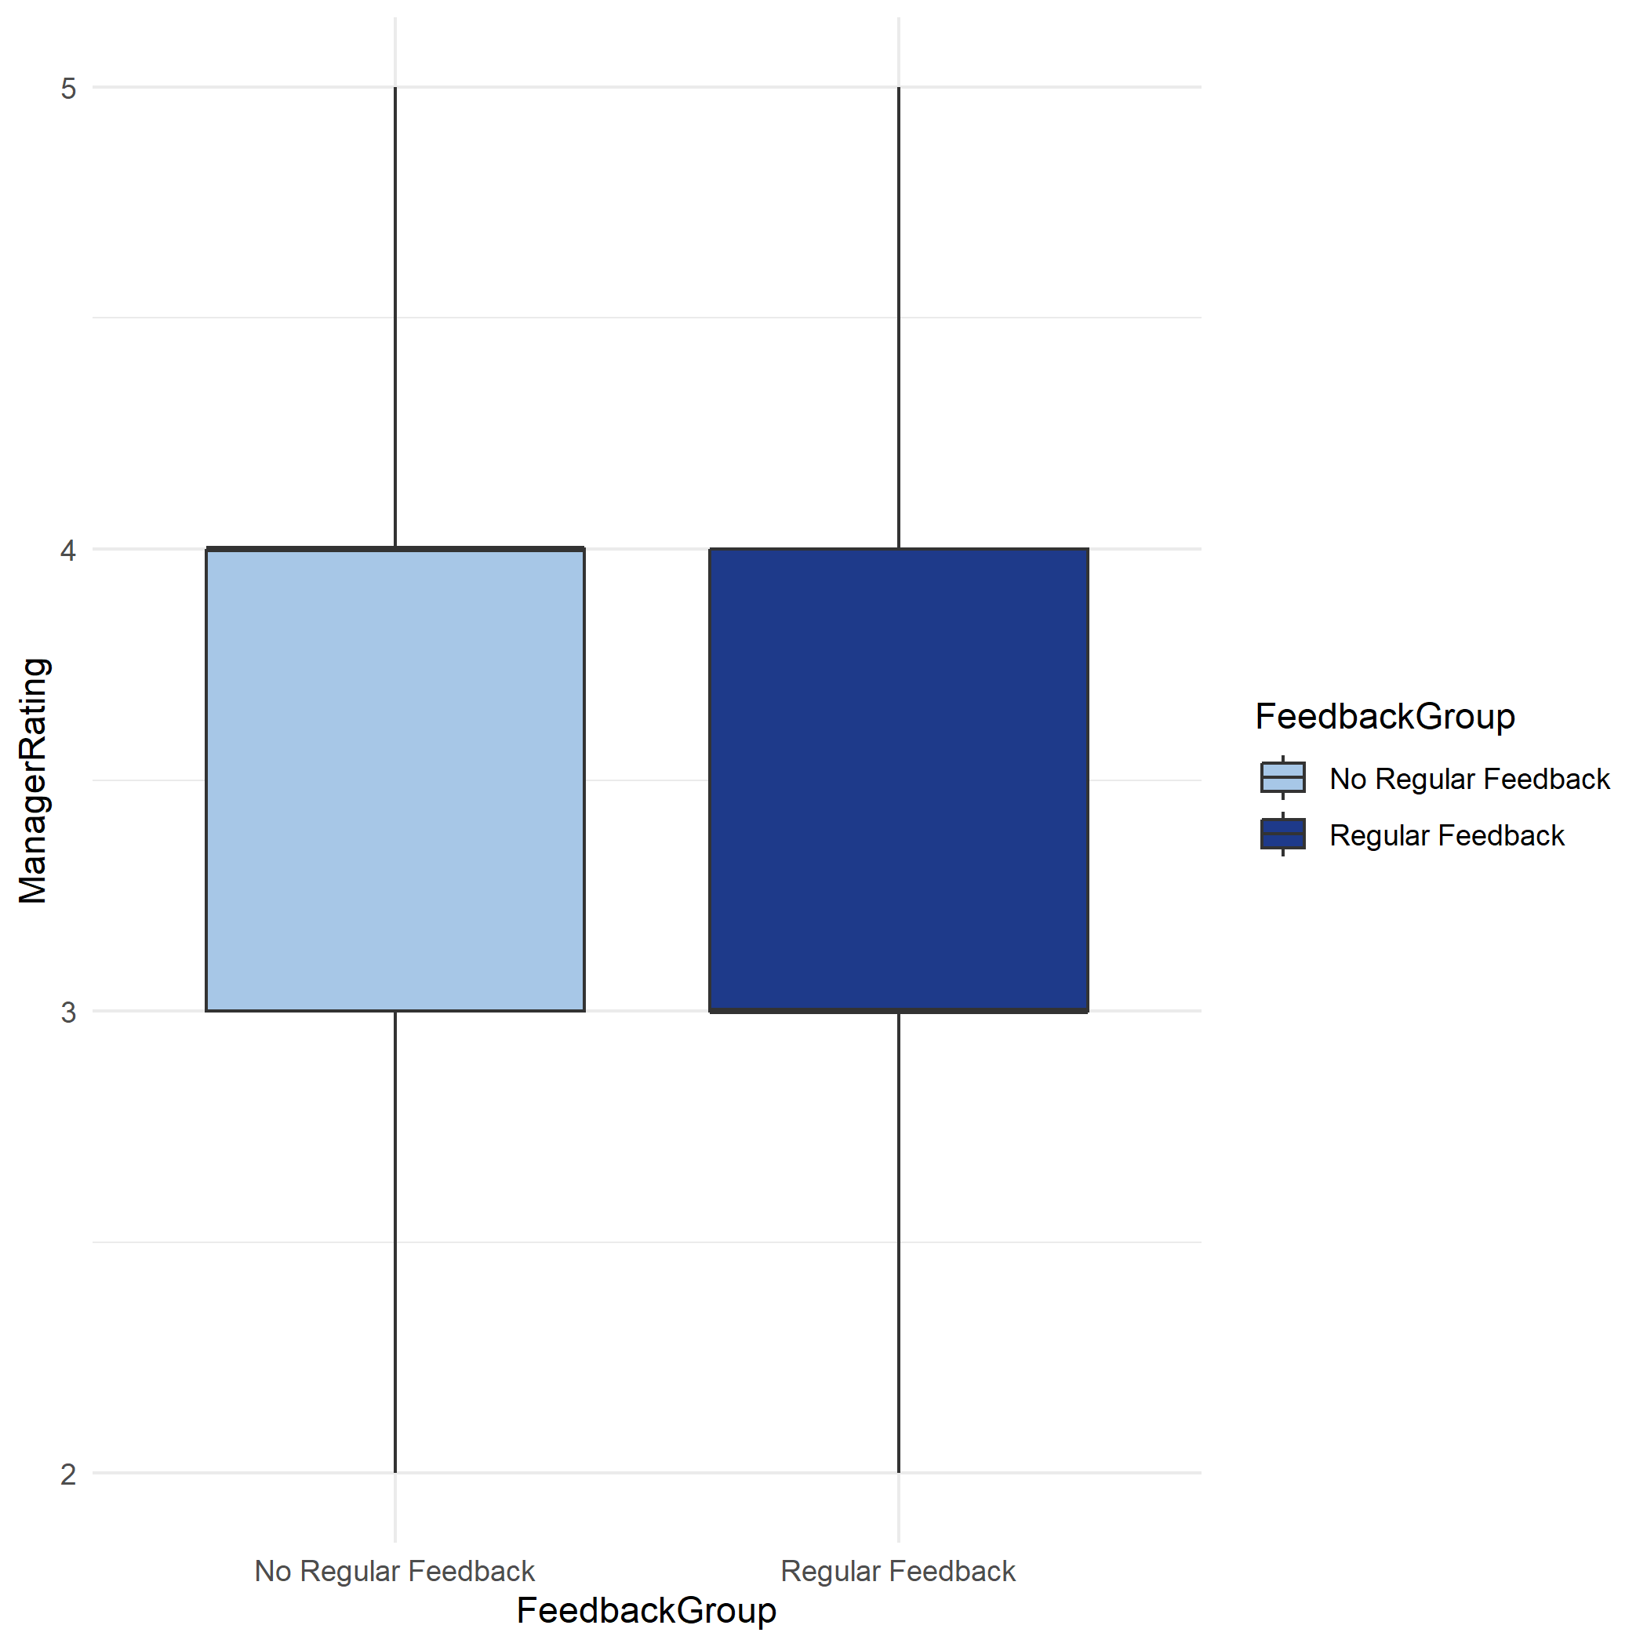
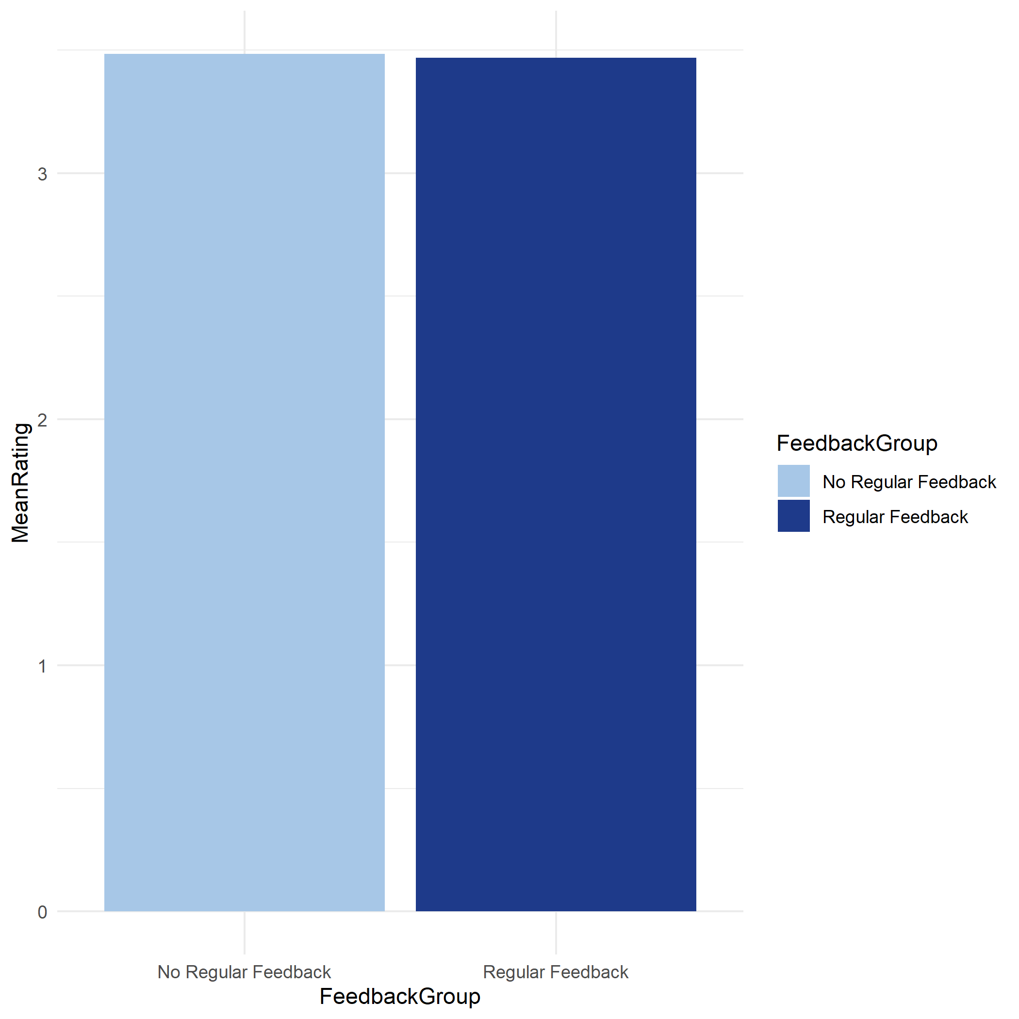
Descriptive Analysis
Summarising and comparing performance across feedback groups

Slide 8
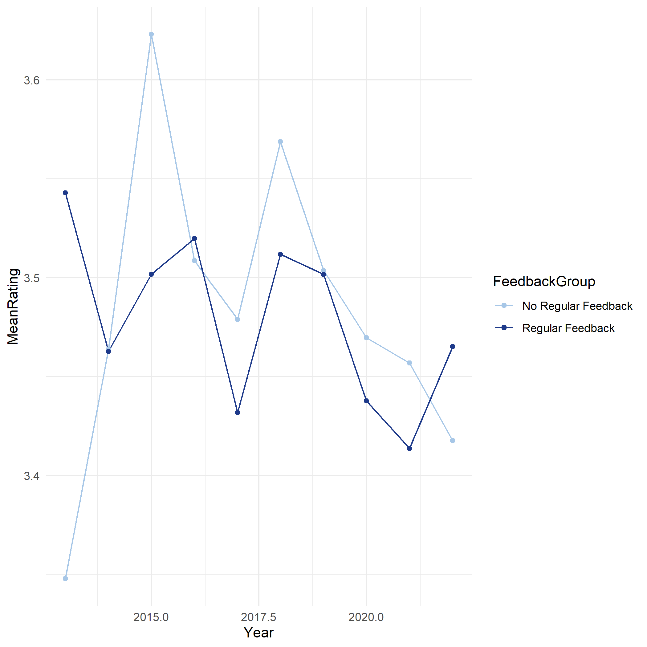
Time Series Analysis
Summarising and comparing performance across feedback groups

Slide 9
Inferential Analysis
Four statistical tests — all at significance level alpha = 0.05
H0: No significant difference in manager rating between groups H1: Regular feedback group has significantly higher ratings alpha = 0.05
t-test (one-tailed)
Chi-Square Test
Compares mean ManagerRating between 2 groups. One-tailed because H1 is directional.
Tests association between FeedbackGroup and HighPerformer — both are categorical variables.
t = -0.672
p = 0.501
chi-sq = 2.341
p = 0.126
FAIL TO REJECT H0
FAIL TO REJECT H0
One-Way ANOVA
Pearson Correlation
Compares all 3 training levels (1, 2, 3 sessions) simultaneously. t-test only compares 2 groups.
Tests linear relationship between training sessions (number) and manager rating (number).
F = 0.253
p = 0.776
r = -0.009
p = 0.484
FAIL TO REJECT H0
NO SIGNIFICANT CORRELATION
All 4 tests returned p > 0.05 — We FAIL TO REJECT H0

Slide 10
Predictive Model
Multiple Linear Regression + Logistic Regression
Model 1 — Multiple Linear Regression
Model 2 — Logistic Regression
Why this model:
Why this model:
Outcome (ManagerRating) is a NUMBER — scale 2 to 5
We have 7 predictor variables — so MULTIPLE, not simple
Outcome (HighPerformer) is a CATEGORY — High or Low
Linear regression cannot predict categories — predicts numbers only
Logistic regression converts output to probability, then classifies
Results:
Results:
R-squared:
0.729
72.9% variance explained
Accuracy:
84.4%
Training coef:
0.000
No effect on rating
Precision:
83%
SelfRating coef:
1.008
Dominant predictor
Recall:
86%
Training OR:
~1.0 (no effect)
Both models confirm: Training variables have near-zero coefficients — feedback does not predict performance.

Slide 11
Results
Summary of all analytical findings
Descriptive Analytics
Inferential Analytics
Mean ratings: 3.485 vs 3.468 — difference of only 0.017
High performer rate: ~49% in BOTH groups — virtually identical
t-test: p = 0.501 | ANOVA: p = 0.776
Chi-Square: p = 0.126 | Correlation: p = 0.484
ALL 4 tests: Fail to Reject H0 (p > 0.05)
Time Series Analysis
Predictive Analytics
10 years of data (2013–2022) shows no consistent pattern
Lines cross 6 times — no stable advantage for regular feedback
Linear Regression R2 = 0.729 — driven by SelfRating (coef = 1.008)
Training coefficient = 0.000 — adds nothing to prediction
Logistic Regression accuracy = 84.4% — training not significant
Consistent finding across ALL 4 analytical approaches: No support for the statement

Slide 12
Final Decision
DECISION: FAIL TO REJECT H0
The statement is NOT supported by the statistical evidence from this dataset.
Why We Fail
What This Means
What It Does NOT Mean
All 4 inferential tests returned p > 0.05
Mean difference = 0.017 — negligible
Time series: no consistent direction over 10 years
Both regression training coefficients ≈ zero
H0 stands — no sufficient evidence for H1
Feedback quantity does not predict performance
High performer rate identical in both groups (~49%)
This is a valid and important academic finding
It does NOT mean feedback is useless
It means THIS dataset cannot confirm the statement
Proxy variable (training count) may miss quality
Future research with better data may find different result
Limitation:
TrainingOpportunitiesWithinYear is a proxy — measures frequency of sessions offered, not quality of feedback received.

Slide 13
Conclusion
Summary, limitations, and recommendations
Summary of Findings
We tested the statement from 4 analytical angles — descriptive, time series, inferential, and predictive analytics
All approaches consistently showed no significant relationship between feedback frequency and performance
The conclusion is robust — it is not an accident of one test, but consistent across every method applied
Limitations
Recommendations for Future Research
Proxy variable — training session count measures frequency, not quality of feedback
Cross-sectional data — cannot establish cause and effect
Confounding variables not fully controlled (role, manager style)
Collect direct qualitative feedback data — quality not just frequency
Use longitudinal tracking of same employees over time
Control for job role and department in future analysis
Thank You — IT3011 Group Assignment

